Slide 1



Id Server
Facebook
5
Token
6
Authorization Code
ClientId + callback URL
2
Redirect to external IP login page
4
Login
3
Mobile browser
Uses AuthCode to retrieve identity and
refresh tokens
8
1
Navigate to https://IdServer.com/authorization/...
7
Mobile app retrieves auth code (polling)
Mobile App

Slide 2
Id Server
Use refresh token to retrieve
identity token and new refresh token.
1
Mobile App

Slide 3

Get the Json Web Key Tokens and check the identity token
Id Server
2
Profile service
3
Get a valid access token for the scope “scim_manage”
4
Use the access token to patch
the representation
Auth Server
SCIM2.0
Mobile App
1
Use the identity token to update the address

Slide 4
Get the Json Web Key Tokens and check the identity token
Id Server
2
Profile service
Retrieve a valid access token for the scope “scim_read”’
3
4
Use the access token to get
the representation
Auth Server
SCIM2.0
Use identity token to get the latest representation
Mobile App
1
5
Representation is returned

Slide 5

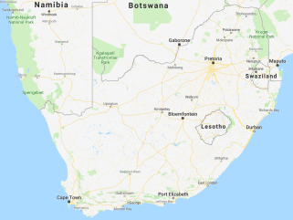



Auth Server
2
Get valid access token for the scopes “scim_read”, “barcode_read”, “testresult_read”
SCIM2.0
BarCode API
Test Result API
Use the access token
to search the bar codes
4
Use the access token to search the representations based on location / gender / ethnicity etc…
Use the access token to search the test results
3
5
Reporting API
VL > 30000
Search the results
Results returned
20000 < VL > 30000
1
6
10000 < VL > 20000
Reporting Website
VL > 10000

Slide 6












InMemory caching
Postgres repo
Sqlite repo
Redis caching
SqlServer repo
InMemory repo
OAuthRepository
EventStore Handler
SqlServer sink
ES sink
File sink
Storage repository
RabbitMq
Bus
InMemory
Logging
OpenId Host

Slide 7



Postgres repo
Sqlite repo
SqlServer repo
InMemory repo
EventStore repository
EventStore Host

Slide 8
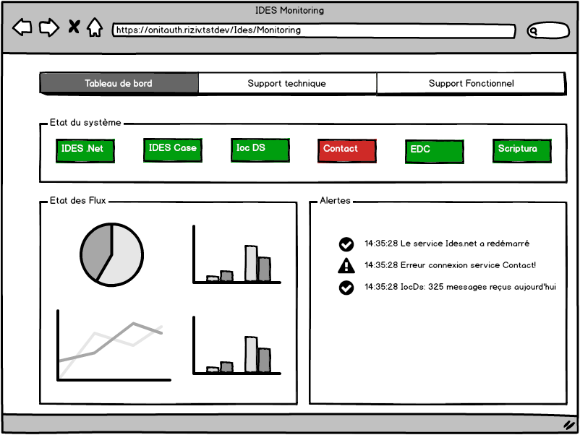
CASE 360
DB Servers
Consolidation DB
1
vwAtpMilestones
Atp
Support website
App Fabric
2
ValidateAtp
DossierWriter
Service
3
WriteAtp

